Slide 1
CES 361
Fundamentals of Software Testing
Session 10

Slide 2
What is the difference between
computer programming, and
software engineering?

Slide 3
On a recent flight
Seated beside an RN who worked as an IT consultant for a hospital information system
She had been involved in implementing the system in Miami Valley; now was working in Pittsburgh doing the same thing
She said, “When we first put the system together, we used a ‘big bang’ approach, so it went pretty quick…”
“…it only took two-and-a-half years”

Slide 4
Use Case Scenarios
Designed to show how a system would work, from the user’s point of view.
Works well in transaction-based systems that tend to have well-defined UIs
After preconditions are defined, this is much like a tennis match: trigger, response, trigger, response…
Initially, stay on “happy path.” Fill in exceptions during subsequent iterations
For example…

Slide 5
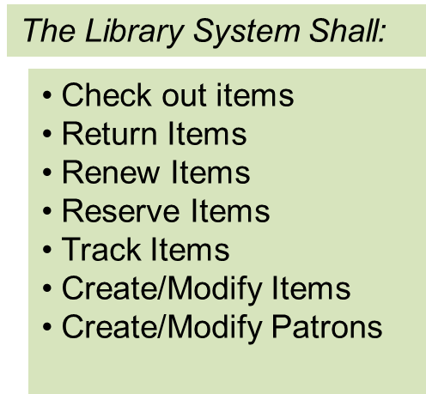
Library Business Rules and Subsystems
RESTRICTIONS
PG-13 Videos R-Rated Videos Explicit CDs | Must be 13+ Must be 17+ Must be 16+
Outstanding Fines Number of Items | Must be <= $5.00 Must be <=30
CHECKOUT TIMES
Videos CDs Books | 1 Week 2 Weeks 3 Weeks
RENEWAL LIMITATIONS
Videos CDs Books Requested Item | 2 times 2 times 6 times 0 times
Let’s work on Returns...
Your mission: Write a use case
FINES
Videos CDs Books | 50¢ per day 25¢ per day 10¢ per day

Slide 6
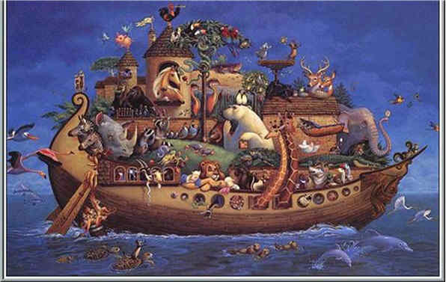
Let’s Get Started..
What are the preconditions?
What is the trigger?
How does the rest of it look?
Stay on the “happy path” for this example
Let’s see what you’ve got
What exceptions might we need to have?
GO

Slide 7
How would you test it?
REQUIREMENTS
ACCEPTANCE TESTING
ARCHITECTURAL DESIGN
SYSTEM TESTING
COMPONENT DESIGN
INTEGRATION TESTING
CODING
UNIT TESTING
DEVELOPMENT
TESTING
Question: Where are we?
Question: What does the V-Model tell us?

Slide 8
This slide intentionally left blank

